Slide 1
Cyclists at Cyclistics
Author: Antonio Colantuono
Last update: December 20th, 2020

Slide 2
Table of contents
Purpose of the analysis
What is the data telling
Conclusions

Slide 3
What’s the purpose of the analysis?

Slide 4
Goal
Identify how members and casuals differ in the way they use Cyclistics service through the analysis of the company’s last twelve months of historical data.

Slide 5
What’s the data telling?

Slide 6
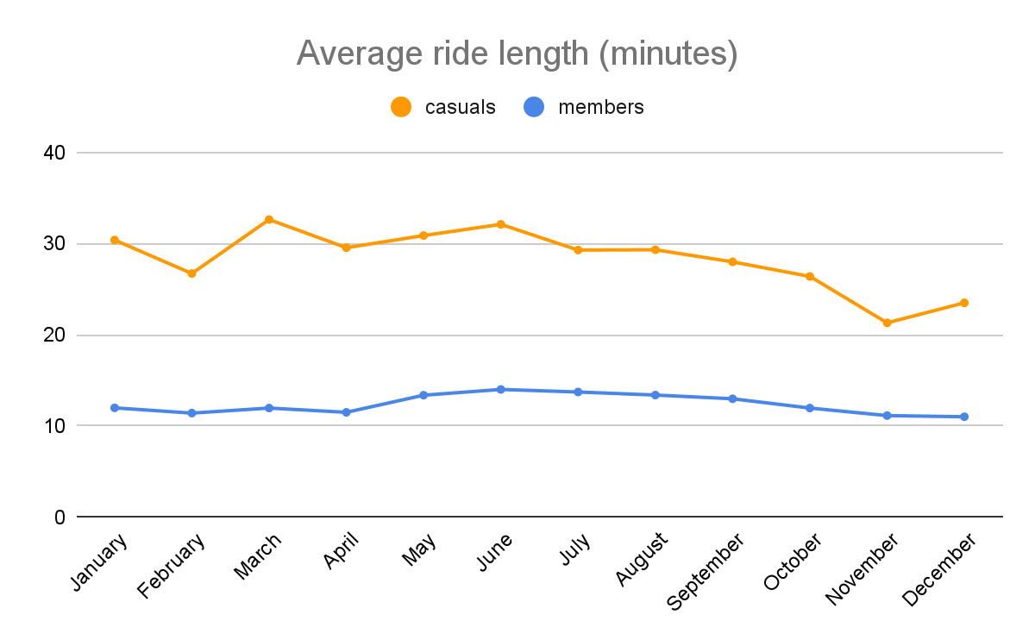
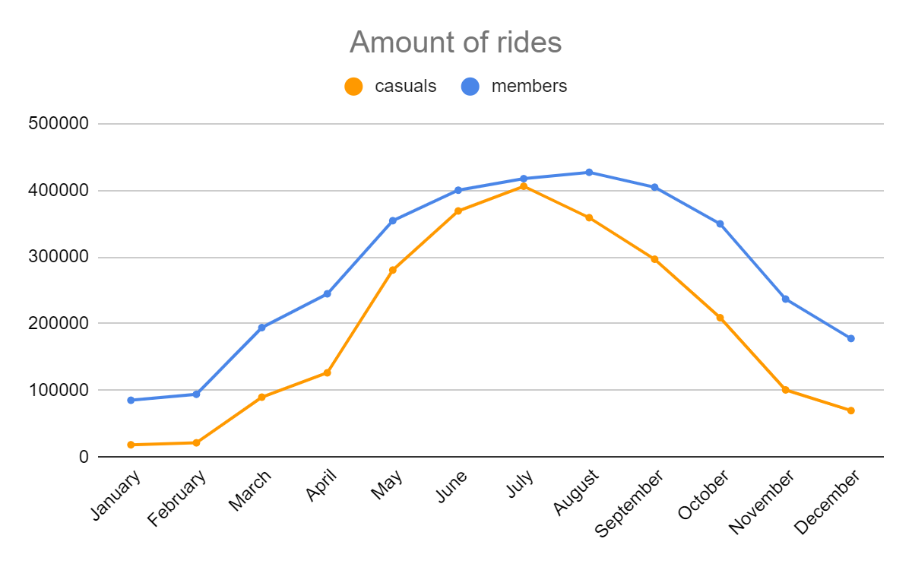
Monthly
Casuals’ ride length is twice to three times as long as members’ rides.
Members’ rides are more spread out while casuals’ rides appear to be concentrated within may to september.

Slide 7
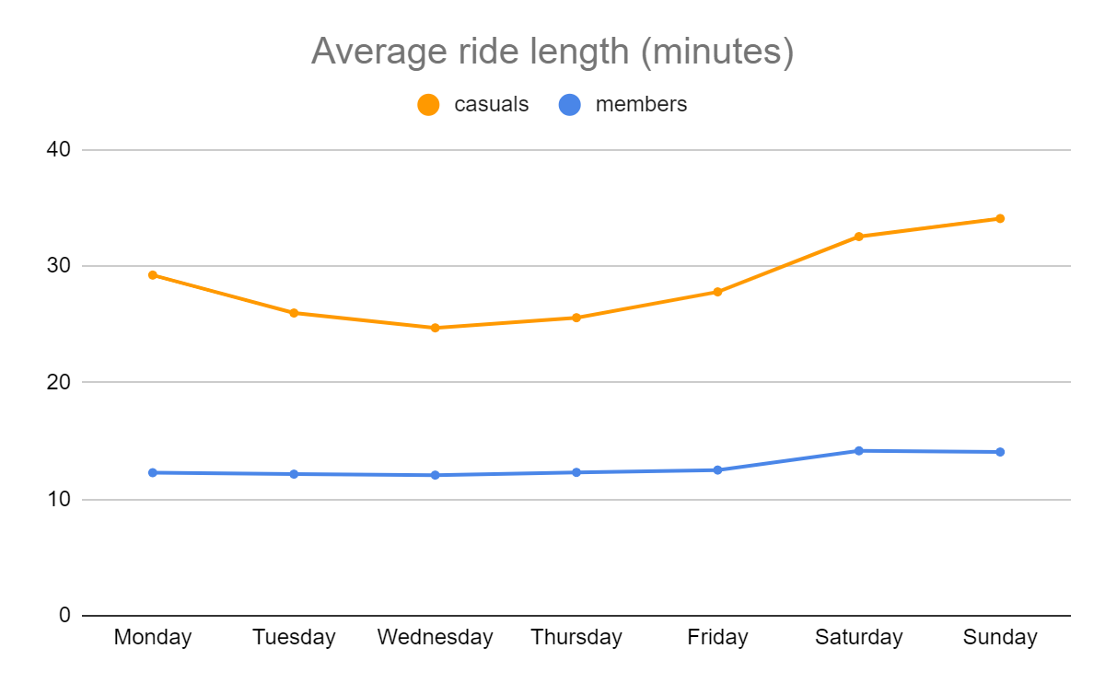
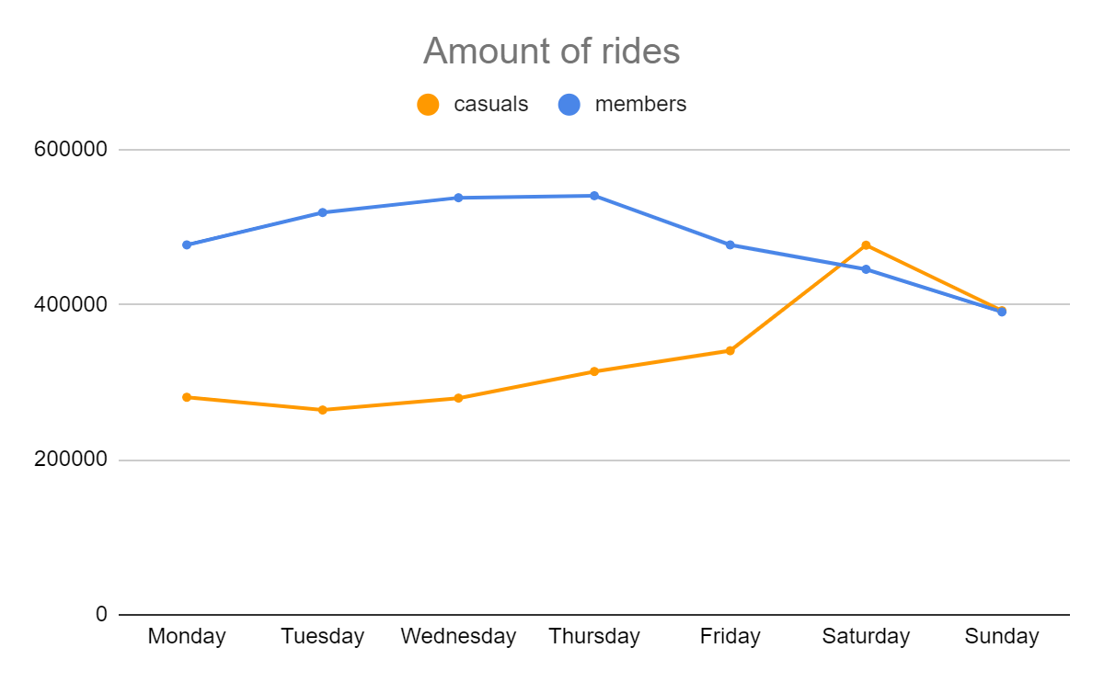
Weekly
Casuals’ ride length is twice to three times as long as members’ rides.
Members’ rides appear to be almost double compared to casuals’ during weekdays. However, casuals’ rides are slightly more than members’ during weekends.

Slide 8
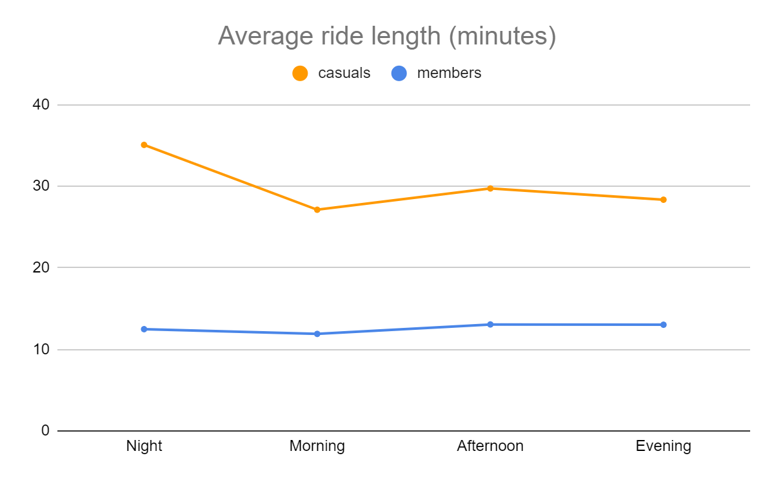
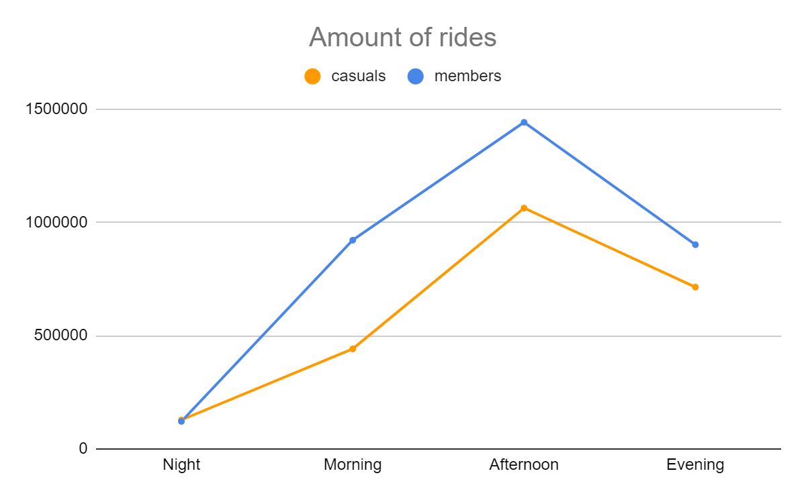
Daily
Casuals’ ride length is twice to three times as long as members’ rides.
The difference between the amount of rides of members and casuals is the biggest during the morning (6-12).

Slide 9
Conclusions

Slide 10
What to take away
Casuals’ rides appear to increase during weekends and summer in contrast with members whose rides are more during the weekdays and the rest of the year.
Casuals’ ride length is bigger compared to members’.
Casuals and members profiles appear to be definitely different.
Further analysis could take place with the help of surveys to better understand the behavior of casuals in order to create an offer that suits their needs the best.

Slide 11
Thanks for your attention

